Slide 1
IBM WebSphere Application Server 8.5
What’s new?
(que ce qui est bien…)
Thomas Bussière- bussiere@fr.ibm.com
IT Architect
Business Solution Center
La Gaude, France
-- WAS 8.0 Administrator certified

Slide 2
WebSphere Application Server:
Liberty Profile

Slide 3




WAS v8.5.5 delivers significant enhancements to Liberty profile, including new programming models, administration, qualities of service and development tools
Dynamic Server Profile
Not static like Web Profile; configured by app at a fine-grained level
“Developer First” Focus
Simplified, shareable XML server config. New integrated messaging server, DynaCache support, new prog. models, such as Web Services, JMS & EJB-Lite.
Start fast, run efficiently
Starts in <3s; Mem footprint <50MB; (TradeLite benchmark)
Small Download
50MB for Web Profile features
Dynamically Extensible
Install new features from repository (local or remote) with no svr restart
Integrated tools
Powerful tools in WDT Eclipse feature. Enhanced for v8.5.5 prog models, Maven integration, ++
WAS v8.5.5 Liberty
Profile &
WAS Developer Tools for Eclipse (WDT)
Lightweight cluster Mgmt
Liberty servers can join a lightweight cluster for workload balancing and high availability
Web Profile Certified
Create web apps for the Java EE Web Profile standard.
Unzip install and deploy
IM or unzip to install. New option to deploy “server package” of app + config + required subset of server runtime for highest density deploy
Liberty Extensions
Add custom features and integrate 3rd party components via Liberty extensions interface
Fidelity to full profile WAS
Same reliable containers & QOS. Develop on Liberty profile and deploy to Liberty or full-profile WAS
Notes:
3

Slide 4
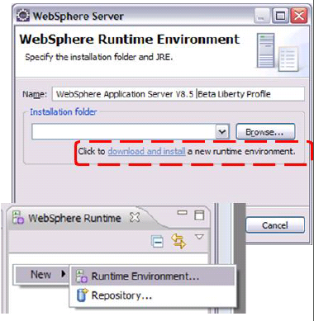
No Hurdles to Install
Tools and runtime are free for development. No time limit
Eclipse feature install for tools; 40MB zip download for server profile.
  Installation Manager also supported → same installed result.
Two minutes from “Nothing” to “Done”:
1.Install WAS Developer Tools for Eclipse Feature
2.Use the Tools to download the WAS Liberty Profile or download 40MB zip from WASdev.net

Slide 5
WebSphere Application Server:
Liberty Demo 1

Slide 6

Simplified Server Configuration
Simplest case: 1 XML file for all server config
Editable within the workspace
Exportable, shareable, versionable

Slide 7
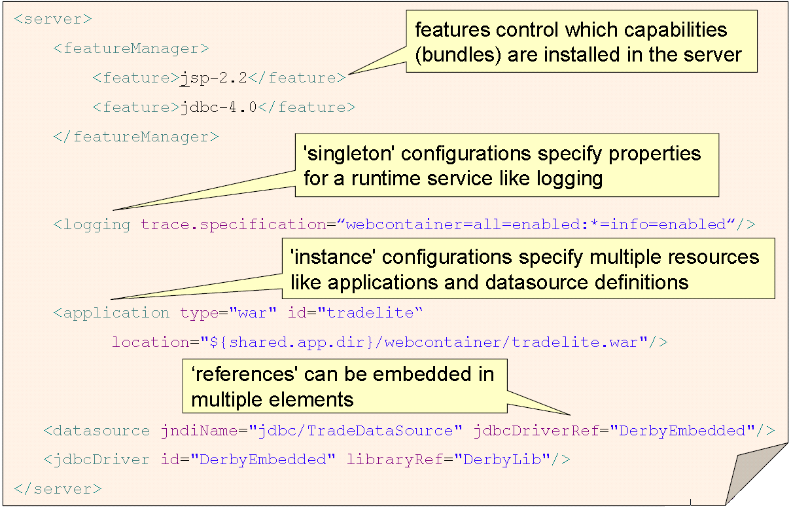
Simplified Configuration

Slide 8
Highly Composable Runtime Based on ‘Features’
WAS v8.5.5 delivers programming model and qualities of service enhancements to the Liberty profile, expanding the scope of Liberty based applications and deployment
WAS Extensions
Java EE Support
zosTransaction
zosWlm
beanvalidation
zosSecurity
appSecurity
jaxrs
osgi.jpa
localConnector
blueprint
restConnector
ssl
jsf
wab
json
Runtime Services
&
Config Model
jsp
monitor
sessionDatabase
servlet
jpa
jndi
jdbc
Feature Manager
HTTP Transport
Application Manager
Full WAS Profile
WAS v8.5 Liberty Profile
Notes:
Builds.
This is the V8.5.0 view
Since June last year the WAS Liberty profile has delivered “fit for purpose” composability to a much more granular level than the Java EE platform specification.
Click: Applications that require only servlet, JSP and JPA define only those 3 feature in the server.xml configuration and this is all that the runtime will start. That gives you a lightening fast startup for the development environment and a minimal memory footprint in production.
Click. Another application that requires JSF can add the JSF feature and the server will start that. During the development of an application you can add and remove features without needing to restart the server so ssl and appSecurity can be added as a new application is developed and application functionality increased. An important point to note is that these features are all available with WAS – they don’t need to be assembled from multiple sources to deliver the target functionality. But you don’t pay the runtime price until you need them.
Click. The Liberty profile is part of all editions of WAS inclusing WAS for zOS. Platform-specific exploitation is enabled through the feature mechanism with granular z-specific features for exploitation of platform-specific integration of transactions, wlm and security.
In all cases the mechanism by which a feature is “enabled” in the Liberty profile is to list it in the server.xml configuration - 1 line of XML per feature.

Slide 9
WebSphere Application Server Editions Positioning summary
Express
Base
Full profile
ND
Full profile
Systems of Record
Web + JEE Apps
WAS Base with
capacity-limited license
(480 PVUs per server)
Web, Java EE apps and
extensions
Secure, high performance
transaction engine
+ High availability
+ Intelligent mgmt
+ High scalability
and more…
Liberty Core
Liberty profile
included w/ Base
Liberty profile
included w/ ND
Systems of Engagement
Simple Web Apps
Everything in Liberty Core
+ Java messaging
+ Web services
+ noSQL DB
Web, mobile, OSGi apps
(Web profile specification)
Subset of Liberty profile
+ Enterprise class clustering
+ Topology management
Handful of servers
Dozens of servers
Hundreds of servers
Hundreds of concurrent users
Thousands of concurrent users
Notes:
JBoss competitive presentation
27/03/2014
IBM Internal Use Only
9

Slide 10
zosWlm
zosSecurity
zosTransaction
collectiveController
clusterMember
z/OS
mongodb
jaxb
jaxws
ND
wsSecurity
wmqJmsClient
jmsMdb
wasJmsSecurity
Base, Express
Liberty Core
concurrent
wasJmsClient
wasJmsServer
oauth
collectiveMember
ldapRegistry
webCache
ejblite
cdi
managedBeans
jaxrs
osgi.jpa
localConnector
beanvalidation
blueprint
restConnector
ssl
jsf
wab
json
appSecurity
jsp
monitor
sessionDatabase
servlet
jpa
jndi
jdbc
Feature Manager
HTTP Transport
Application Manager
Notes:
Group block animation.
V8.5.5 of WAS continues with this theme and and extends it by enabling more of the componentry of the full WAS profile to run on the composable Liberty profile.
Click. For the WAS Liberty profile in all editions of WAS, we have added modular capabilities that include the completion of the Java EE 6 web profile as well as deliver additional caching and security features, which we’ll talk about later in more detail.
The new WAS Liberty core edition mentioned earlier contains all these features, coloured blue in the chart; the ones that have been added in V8.5.5 are indicated with a star.
Click. For the WAS Liberty profile in WAS Base, Express, ND and zOS we have added additional modular features to support JAX-WS web services, JMS applications and access to MongoDB NOSQL database.
Click. For the WAS Liberty profile in ND and zOS we have added management features that enable clusters of Liberty profile servers to be managed remotely through a lightweight, highly-available administrative controller which is itself simply a Liberty server – or a group for HA – that is configured in this role. We’ll also talk about this in more detail later.
Click. The WAS Liberty profile in WAS for zOS extends the ND feature set with features that integrate with and exploit capabilities of the zOS platform.
The overriding design point for Liberty is: provide greater coverage of features and management capability but continue to only use what you need. An application developed against the V8.5.0 feature set will run the same in V8.5.5, with the same set of features and a similar server footprint – the additional features that aren’t used do not contribute to the footprint. It’s a bigger menu but you don’t need to eat more.
And, of course, the fidelity provided between the WAS Liberty and full profiles means applications developed on the WAS Liberty profile will also run on the WAS full profile. Only the server configuration is different.

Slide 11
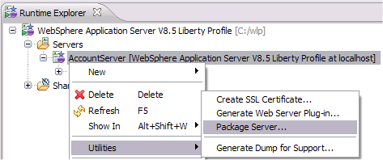
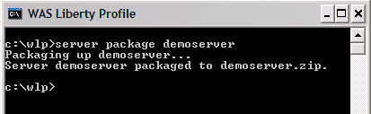
“Packaged Server” Deployment Option
Package up a compressed archive of a configured Liberty server type along with its applications
  Directly from Eclipse
  environment
  Resulting zip can be copied to
  integration or production
  environment and unzipped.
For test automation outside the IDE, a
command-line program to manage the
lifecycle of server instances:
  Create [serverName]
  Start and stop [serverName]
  Package [serverName]
  Status [serverName]
Updates to configuration of running server are effective immediately.
Add/remove apps dynamically by drag/drop to monitored directory.

Slide 12

Minimized Server Packages
jaxb
Liberty extended archive 30MB
wsSecurity
wmqJmsClient
jmsMdb
wasJmsSecurity
jaxws
wasJmsClient
wasJmsServer
Install only what you need to
minimize disk footprint.
  Modular “Archive Install” or
  Standalone Installation Manager
  repository
Start only what you need - only configured features are started by the Liberty kernel to
minimize memory footprint
Package only what you need to
minimize a packaged server:
server –package serverName --include=minify
oauth
collectiveMember
ldapRegistry
webCache
ejblite
cdi
managedBeans
jaxrs
osgi.jpa
localConnector
beanvalidation
Liberty runtime
archive 50MB
(Java EE Web Profile)
blueprint
restConnector
ssl
jsf
wab
json
appSecurity
jsp
monitor
sessionDatabase
servlet
jpa
jndi
jdbc
Feature Manager
HTTP Transport
Application Manager
Notes:
Imagine you have installed the WAS Liberty server and developed and tested your application in the development environment. What next?
In V8.5 we introduced the notion of “Liberty server packaging” – a simple mechanism supported from the command line and tooling to produce a completely self-contained archive of an application, the server definition required for the application and optionally the Liberty server runtime itself – this delivers a dramatically simplified approach to moving an application through the delivery lifecycle from dev to integration to pre-prod to production: very easily scriptable and simple to integrate with arbitrary continuous delivery systems.
An enhancement we have added in V8.5.5 applies the intelligence of runtime modularity to the server packaging step, analyzing the precise set of features required at runtime and ONLY packaging those in the archive – thereby minimizing the size of a packaged server to include only what is required by the application – no space in the archive is wasted. We call this the “minify” option of the server package command.
We have also modularized the install of the Liberty profile so can choose how much to actually install in the first place – for example the WebProfile-compliant set of core Liberty features is a 50MB installl; additional capabilities like JMS and Web services add a further 30MB. Of course, regardless of how much you install, we never load more than is needed at runtime.
So now there is “minimality” in everything you do with the WAS Liberty profile – minimal install, minimal footprint, and minimal packaged servers.

Slide 13
Capability | WAS Liberty Core | WAS Express |  | WAS (Base) |  | WAS ND/zOS
 |  | Liberty | Full WAS | Liberty | Full WAS | Liberty | Full WAS
Web Profile (subset of full Java EE prog model: Servlet; JSP; JSF; EJB-Lite; CDI; managed beans; JTA; JPA; ...) + JAX-RS + JDBC + osgi + mobile toolkit | X | X | X | X | X | X | X
Fidelity from Liberty to full WAS | X | X | X | X | X | X | X
Optional provisioning & management through ND job manager | X | X | X | X | X | X | X
IHS routing (# of servers allowed) | 2 | 2 | 2 | 25 | 25 | Unltd | Unltd
Load Balancing / Failover (# of servers allowed) | 2 | 2 | 2 | 5 | 5 | Unltd | Unltd
SPI (allows 3rd party extensions to Liberty features) | X | X |  | X |  | X
Archive install | X | X |  | X |  | X
Collective Controller (1) Membership, and (2) Management | X(1) | X(1) |  | X(1) |  | X(1,2)
JAX-WS WebServices, JMS, MDB |  | X | X | X | X | X | X
Full Java EE (+ JCA, Java Mail, full EJB, JAX-RPC, JAX-R, ...) |  |  | X |  | X |  | X
Expanded Programming Models (CEA, SIP, SCA, Batch) |  |  | X |  | X |  | X
WXS entitlement – XS Container JVMs for Distributed Cache scenarios (# of separate servers) |  |  |  | Unltd (1) | unltd(1) | Unltd(2) | Unltd (2)
Edge of Network Services |  |  |  |  |  | X | X
Liberty z/OS extensions |  |  |  |  |  | X(z/OS)
Intelligent Management (dynamic cluster, Edition Management., Health Policy) |  |  |  |  |  |  | X
WebSphere Developer Tools (Java EE, osgi, web 2.0, mobile) | X | X | X | X | X | X | X
Rational Application Developer (complete prog model) | X | X | X | X | X | X | X
HTTP session management and DynaCache only
WXS client on z/OS only

Slide 14
WAS v8.5.5 Family
WAS for Developers
WAS Hypervisor Edition
WAS ND
WAS for z/OS
Tools
Edition
Liberty
and Full
Profiles
+WXS
Liberty
and Full
Profiles
Intelligent
Mgmt
+WXS
Tools
Edition
Liberty
and Full
Profiles
Intelligent
Mgmt
+WXS
Liberty
and Full
Profiles
Intelligent
Mgmt
+WXS
Client
Enables efficient
development of innovative apps that will run on WAS in production
Available as a
no-charge edition for the developer desktop and includes Eclipse adapters
The WAS ND server optimized to instantly run in Pure Application System, VMware, PowerVM, zVM and other server virtualization environments.
Delivers near-continuous availability, with advanced performance and intelligent management capabilities, for mission-critical apps.
Takes full advantage of
the z/OS Sysplex to deliver a highly secure, reliable, and resource efficient
server experience.
Full entitlement to WXS.
Entitlement to WXS z/OS client.
WAS
Provides secure, high performance transaction engine for moderately sized configurations with web tier clustering and failover across up to five application server profiles.
Tools
Edition
Liberty
and Full
Profiles
+WXS
Includes entitlement to eXtreme Scale for HTTP session caching and DynaCache on the entitled WebSphere Application Server.
Provide WAS and WDT editions as freely available for dev desktops and supported under production runtime licenses
WAS Liberty Core
WAS Express
Liberty Profile
(Web Profile only)
Liberty
and Full
Profiles
A lightweight and low-cost Liberty based offering (not full-profile WAS), providing the capabilities to rapidly build and deliver web applications.
A lightweight and low-cost Liberty profile based offering (not full-profile WAS), providing the capabilities to rapidly build and deliver web apps that do not require the full Java EE stack.
A low-cost, ready-to-go solution to build dynamic Web sites & apps, including both Liberty and full-profile WAS. Restricted to a set amount of PVUs.
Notes:
14
14
14
14

Slide 15
Java EE Web Profile Completion
Supported by all WAS editions
Enables a lightweight and standard runtime as a best practice for building web applications
Web profile specification: <feature>webProfile-6.0</feature> enables all
  Servlet 3.0
  JavaServer Pages (JSP) 2.2
  Expression Language (EL) 2.2
  Debugging Support for Other Languages (JSR-45) 1.0
  Standard Tag Library for JavaServer Pages (JSTL) 1.2
  JavaServer Faces (JSF) 2.0
  Common Annotations for Java Platform (JSR-250) 1.1
  Java Transaction API (JTA) 1.1
  Java Persistence API (JPA) 2.0
  Bean Validation 1.0
  Enterprise JavaBeans (EJB) 3.1 Lite + Interceptors 1.1:
  Managed Beans 1.0:
  Contexts and Dependency Injection: JSR-299 1.0 and JSR-330 1.0
jpa
jsf
jsp
beanvalidation
servlet
appSecurity
jndi
jdbc
ejblite
managedBeans
cdi
v8.5.5
Notes:
Lets look at what’s new in V8.5.5 in a little more detail.
First we have the completion of the EE Web Profile. WAS V8.5.0 focussed on the features used by the majority of web applications. At that time we did not include the Java EE ManagedBeans 1.0, CDI 1.0 or EJBLite capabilities on the Liberty profile, although of course these have been available on the WAS full profile since our EE6 compliant release WAS V8.0 in 2010.
In WAS V8.5.5 we have enabled these 3 features on the Liberty profile. An application that used all the technologies of the EE Web profile could either define the 11 features shown as blue lego bricks here, or the single webProfile-6.0 feature which is synonym for these 11 features. You’ll notice there are some technologies in the web profile that do not appear to map directly to features you define in server.xml – JTA transactions for example. In fact these are loaded as features by the Liberty kernel but they are implicit dependencies of other higher-level features such as JPA. This simplifies the overall development experience without requiring the developer to explicitly configure features that can be calculated as implicit dependencies.

Slide 16
EJB-lite Support
 | EJB 3.1 Lite (Liberty and Full Profile) | Full EJB 3.1 (Full Profile)
Session Beans (stateful, stateless, singleton) | ✔ | ✔
Message Driven Beans |  | ✔
2.x/1.x CMP/BMP Entity |  | ✔
Java Persistence 2.0 | ✔ | ✔
Local/No Interface | ✔ | ✔
3.0 Remote |  | ✔
2.x Remote Home/Component |  | ✔
JAX-WS web services |  | ✔
JAX-RPC web services |  | ✔
EJB Timer Service |  | ✔
Async Bean Invocation |  | ✔
Interceptors | ✔ | ✔
RMI-IIOP interop |  | ✔
Container managed transactions / Bean managed transactions | ✔ | ✔
Declarative Programmatic Security | ✔ | ✔
Embeddable API | ✔ | ✔ (only required for EJB Lite)
EJB 3.1 Lite is a key component of the Java EE Web Profile spec
Subset of EJB 3.1 spec focused on session beans and local interfaces
Keeps EJB implementation small and lightweight
Available in all WAS editions
ejblite
Notes:
A quick word on EJBLite – this is the well-defined subset of the EJB 3.1 specification required for the Web profile. It is a proper subset of the EJB 3.1 specification. With the WAS full profile you get all of EJB 3.1 and indeed earlier versions of the EJB specifications. The ejblite feature of the Liberty profile provides the web profile subset capabilities of the EJB 3.1 spec including:
Stateless and stateful session beans
Managed persistence, transactions and security within the EJB container
Packaging of EJB modules in EARs or WARs.
As we’ll see later, the combination of the ejblite feature with other features for jaxws and jms also enables EJBs to be used as JAXWS endpoints and messages driven beans.
For EJB 2.x, JAX-RPC and remote EJB interfaces you need to use the WAS full profile – these are not part of the Liberty profile.

Slide 17
Web Services
Apache CXF implementation
Supported APIs
  JAX-WS 2.2
  JAXB 2.2
  Web Services for EE 1.3
  Both POJO and EJB based Web services
  JDK bundled APIs also available: SAAJ, JAXP, StAX
Protocols
  SOAP/HTTP
  WS-Security
Simplified development and deployment
  Eclipse WDT wizard supports top down WSDL to Java generation, and bottom up POJO to web service
  Eclipse WDT plugin supports rapid edit-compile-debug cycles
  For EJB based implementation:
    No router WAR generation required
    No EAR wrapper required
jaxws
jaxb
wsSecurity
Notes:
Two features, jaxws and jaxb, are provided for supporting web services on the Liberty profile. Under the covers Liberty use the Apache CXF as its web services engine although for application portability applications may only use the supported APIs (see above).
Supported protocols are SOAP/HTTP and HTTPs as well as WS-Security for message-level security.
WebSphere Developer Tools for Eclipse (WDT), a free Eclipse plugin for which IBM offers optional support, has been enhanced with wizards to support both top down WSDL to Java generation and bottom up POJO to web service development strategies. All WDT tooling capabilities are, of course, also provided with IBM’s flagship RAD product.

Slide 18
Java Messaging Support
JMS and MDB programming models features
Lightweight messaging engine localizes messaging destinations (queues and topics)
  Integrates with transactions and security services
  For development and testing
  Supports security across process boundaries
Inter-operates with WAS full profile SIBus
  Liberty client to full WAS SIBus
  Full WAS JMS client to Liberty
WMQ Client:
  Integration with WMQ for production messaging
wmqJmsClient
jmsMdb
wasJmsSecurity
wasJmsClient
wasJmsServer
Notes:
JMS and MDB programming models are supported by new features.
An embedded lightweight messaging engine is provided and enabled on the hosting server by the wasJmsServer feature.
Destinations defined on a ME on remote Liberty profile or full profile server can be accessed by configuring the wasJmsClient feature.
Destinations defined on a remote WMQ QM can be accessed by configuring the wmqJmsClient feature.

Slide 19
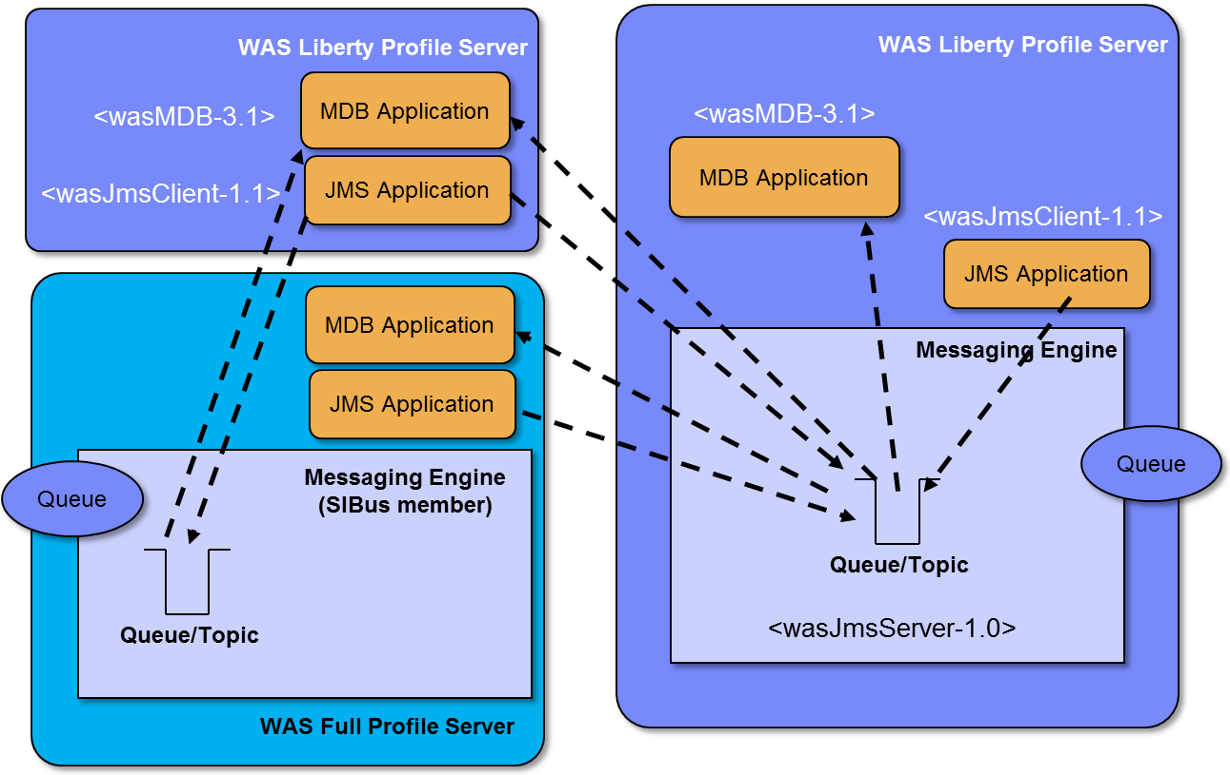
JMS Features
Liberty WAS JMS messaging: all messages are sent and received from a localized ME.
For Messaging Provider HA connect to WMQ or WAS full profile SIBus.
Notes:
19

Slide 20



Support for WebSphere Web Cache
webCache
Local server cache for dynamic web content
Enables developers to easily develop / test applications for local server caching solutions
Same API as full WAS
Optional disk offload
LRU replacement policy
Run as local server cache in production or move applications unchanged to distributed caching via WebSphere eXtreme Scale
Servlet/JSP/
application
DistributedMap API
cachespec
xml
Liberty
implementation
Disk
offload
Notes:
To simplify the development of high-performing web applications, the webCache feature provides the WebSphere dynacache API and declarative servlet cache (cacehspec.xml in WEB-INF or EJB META-INF) configuration on the Liberty profile, along with a built-in in-memory cache implementation with optional disk-offload. Applications and containers can cache and share Java objects by storing a reference to the object in a cache instance that is injected or looked up in JNDI. If any custom object keys are used in the map then a standard Liberty shared library definition is used to provide classloader access.
Cache eviction policy is LRU (least recently used).
e.g. for custom classes in idgenerator.jar
<server>
<featureManager>
<feature>webCache-1.0</feature>
</featureManager>
<distributedMap id="baseCache" jndiName=“cache/one” libraryRef="idgenerator">
<diskCache/>
</distributedMap>
<application type="war" id="dynacachetests" name="dynacachetests" location="dynacachetests.war">
<classloader commonLibraryRef="idgenerator" />
</application>
</server>

Slide 21

Upgrade to WebSphere Extreme Scale for Web Caching
Servlet/JSP/
application
Grid Container
Massive data volume with linear scalability
Elasticity: add more instances dynamically and runtime redistributes data automatically.
Cache consistency
Configurable number of replicas: balance between read and write operations.
  No need to store cache at every application server.
cachespec
xml
DistributedMap API
Grid Container
Grid Container
WebSphere eXtreme
Scale Client
Grid Container
Grid Container
Servlet/JSP/
application
…
Grid Container
cachespec
xml
DistributedMap API
Catalog
Server
WebSphere eXtreme
Scale Client
WXS
Caching
Tier
Notes:
For distributed caching, the built-in cache provider can be replaced by a WXS Liberty feature that moves the storage of the cacheable objects into a caching tier for huge scale and greater availability.

Slide 22
SPI for Liberty Profile Extensions
Add your own Liberty features via OSGi bundles
  Web application bundles also supported
Allows complete integration of third-party function into the Liberty runtime and development tools
Full life cycle: packaging, installation, and un-installation
System Programming Interface (SPI) for:
  Adding your own configuration
  Interaction with Liberty kernel
Class visibility protected by class loader
Sample scenarios:
  Extend OSGi applications programming model
  Provide new infrastructure (i.e. Custom User Registry)
Notes:
One of the great benefits of the modularity of the WAS Liberty profile is that it is very easily extensible. Unless platform extensibility is built in by design, extension can be very difficult to accomplish in a first class fashion – many platforms offer extensibility but not on the same terms as the core platform itself. Liberty is extensible by design and offers the extension API in V8.5.5.
- 3rd party and user features are packaged as collections of OSGi bundles with metadata to describe the feature-level services and packages exposed.
WDT tooling provides a project type to assist with authoring of the metadata
3rd party features are installed and uninstalled to the runtime using the same mechanism as platform features and enjoy all the same benefits of dynamic lifecycle management and isolation.
Configuration metatypes can optionally be defined for a 3rd party feature to enable feature-specific configuration to be exposed in the server.xml configuration, monitored for changes for the Liberty runtime, and injected into the feature when it changes.
This mechanism enable end-users and ISVs to extend the platform in a truly first class fashion.

Slide 23
Security
Secure out of the box
All opened ports are local host only
Exposes no remote management by default
Seamless transition when enabling security
Aim to make security painless
New for Liberty in WAS v8.5.5
  Federated LDAP Repositories
  Custom User Registry
  OAuth
  Password encryption and hashing in config files
Includes the SSL specific code
Includes all the security services (authentication, basic registry, authorization) and web specific security code
ssl
appSecurity
Optionally use one or more (federated) LDAP user registries
ldapRegistry
zosSecurity
Includes the SAF registry and authorization code

Slide 24
Problem Determination
Problem Determination
  Binary Logging
    bootstrap.properties: websphere.log.provider=binaryLogging-1.0
    Much faster than default text files
    Works with same log and trace APIs as default Liberty log and trace
    Use binaryLog tool to filter and retrieve log and trace
    Recommended for production environments to improve trace performance
    Same technology as WAS full profile High Performance Extensible Logging

Slide 25
Monitoring
Feature monitor-1.0
  Uses BCI – no overhead when not configured
  Collects data from various components including:
    JVM
    ThreadPool
    Web Applications
  Attribute to specify which components to monitor and to gather counters in PMI-compatible format.
    <monitor filter="WebContainer,ThreadPool,JVM“/>
    <monitor enableTraditionalPMI=‘true’/>
Data reporting using MXBeans
Can be monitored via JConsole or any standard JMX client
  Including third party tools like Wily/CA Introscope
monitor
    Database Connection pool
    Messaging
    Web services
localConnector
restConnector

Slide 26
Collective Administration
New Liberty collective management infrastructure
  No dependency on full WAS
  Agent-less administration
  Deployment of Liberty topology
  Static cluster management
  Application and server deployment/update
  JMX API through Java, Jython, and Jconsole clients
Configuration:
  Controller: Requires WAS ND or WAS z/OS license
  Managed server:
    May be Liberty core, WAS Base, WAS ND, or WAS z/OS
  Static cluster supported on WAS ND and WAS z/OS
Highly available
Highly scalable: Scales to 1000s of JVMs
collectiveController
collectiveMember
clusterMember
Notes:
Since V8.5.0 it has been possible to manage individual Liberty server processes directly through JMX or through the WAS ND full profile Job manager. Additionally web traffic is workload balanced by the same web service plugin as full-profile WAS to distributed web traffic, maintain session affinity and failover the affinity when needed.
Three new Liberty profile features are introduced in WAS V8.5.5 to provide an end-to-end lightweight administrative capability that does not require the WAS full profile Job Manager. In WAS V8.5.5 ND the collectiveController feature enables one or more Liberty servers to be configured as management endpoint that can proxy one or more clusters of Liberty servers. The set of Liberty servers that may be proxied by the highly available CollectiveController are referred to as the “collective” of servers which may be delegated to – forming a management domain. Liberty servers join a collective by simply defining a collectiveMember feature and registering with the CollectiveController. They retain ownership of their configuration but can be managed through the CC.
The CollectiveController provides operational access to all servers that are members of the collective. This includes operations to start/stop servers, invoke mbeans, and perform file transfer, which supports configuration changes and app install/uninstall scenarios.
The Liberty collective also offers Liberty cluster management support. A collectiveMember server may optionally declare itself a member of a cluster by simply inserting the “cluster” feature into the Liberty server’s config. All server’s that declare the same cluster name are part of the same cluster and can be the target of single management commands targetted through the CollectiveController. It’s that easy.

Slide 27

Liberty Server Management
host 1
host 2
host 3
Apps
Apps
Apps
Apps
Apps
Apps
jsp-2.2
jpa-2.0
restconnector-1.0
appsecurity-1.0
jsp-2.2
jpa-2.0
restconnector-1.0
appsecurity-1.0
jsp-2.2
jpa-2.0
restconnector-1.0
appsecurity-1.0
Feature Manager
servlet-3.0
HTTP Transport
Application Manager
Feature Manager
servlet-3.0
HTTP Transport
Application Manager
Feature Manager
servlet-3.0
HTTP Transport
Application Manager
Liberty Profile
Server 1
Liberty Profile
Server 2
Liberty Profile
Server 3
Collective
Members
(Liberty Core,
Base, ND,
or z/OS)
Apps
Apps
HTTP Server
jsp-2.2
jpa-2.0
restconnector-1.0
Feature Manager
servlet-3.0
HTTP Transport
appsecurity-1.0
Application Manager
Liberty Profile
Server 4
WebSphere plugin
Liberty Collective
All WAS editions eligible to join collectives as members
Only WAS ND and z/OS can be Collective Controller
Apps
Collective
Controller
(ND or z/OS)
Apps
jsp-2.2
jpa-2.0
restconnector-1.0
servlet-3.0
appsecurity-1.0
Liberty Collective Controller
Feature Manager
HTTP Transport
Application Manager
JMX
Client
Management and Monitoring (JMX)
Notes:
27
27

Slide 28
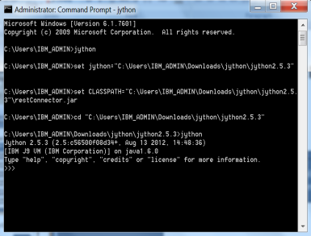
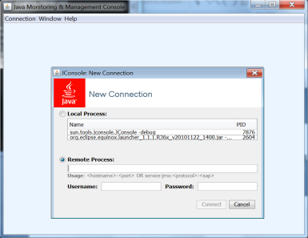
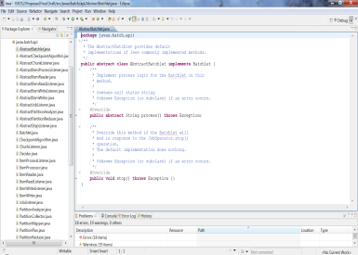

Collectives and Clusters
Liberty Profile
(Collective Member)
Liberty Profile
(Collective Member)
Liberty Cluster A
jython
Controller
Collective
Controller
Only WAS ND and z/OS can be Collective Controller
Provides Operational Registry
Access all members through controller
Highly Available
Secure, Scalable
Agentless
No central config
Liberty Profile
(Collective Member)
Liberty Profile
(Collective Member)
jconsole
Liberty Cluster B
All WAS editions eligible to join collectives as members
Profiles self-assign to clusters (WAS ND and z/OS)
Simple config updates
Easily reversed, reconfigured
Java

Slide 29
WebSphere Application Server:
Liberty Demo 2

Slide 30
host 1
host 2
host 3
1
Liberty Collectives
Liberty Clustering
JMX Monitoring
On Demand Router Plugin
WebSphere eXtreme Scale
2
Apps
Apps
2
Apps
Grid Container
3
Apps
Apps
Liberty Cluster
Apps
4
jsp-2.2
jpa-2.0
restconnector-1.0
appsecurity-1.0
jsp-2.2
jpa-2.0
restconnector-1.0
appsecurity-1.0
jsp-2.2
jpa-2.0
restconnector-1.0
appsecurity-1.0
Feature Manager
servlet-3.0
HTTP Transport
Application Manager
Feature Manager
servlet-3.0
HTTP Transport
Application Manager
Feature Manager
servlet-3.0
HTTP Transport
Application Manager
Liberty Profile
Server 1
Liberty Profile
Server 2
Liberty Profile
Server 3
Grid Container
5
Apps
Apps
Grid Container
Apps
Apps
WAS Full Profile
Server X
WAS Full Profile
Server Y
Apps
Apps
HTTP Server
On Demand Router
jsp-2.2
jpa-2.0
restconnector-1.0
Grid Container
Messaging Cluster
Feature Manager
servlet-3.0
HTTP Transport
appsecurity-1.0
Application Manager
Liberty Profile
Server 4
WebSphere plugin
WAS ND Application Cluster
Grid Container
Liberty Collective
Apps
Apps
4
Apps
Apps
WAS Full Profile
Cluster Member
WAS Full Profile
Cluster Member
…
Intelligent Management Agents
Grid Container
1
WAS ND
Administrative Cell
High Availability Manager
Deployment
Manager
Apps
Apps
Catalog
Server
Node Agent
Node Agent
jsp-2.2
jpa-2.0
restconnector-1.0
servlet-3.0
appsecurity-1.0
Liberty Collective Controller
Admin App
Feature Manager
HTTP Transport
Application Manager
5
WXS
Caching
Tier
3
Browser
Client
JMX
Client
Management and Monitoring (JMX)
Notes:
30
30

Slide 31


Slide 32
The Big Picture : WAS 8.0
Vertically Integrated & Horizontally Fit for Purpose
Operational Management & Efficiency
IBM Workload Deployer (Images, Topologies, Patterns)
WebSphere Virtual Enterprise (Intelligent Mgmt Pack)
Batch Processing & Distributed Caching
WebSphere Compute Grid
WebSphere eXtreme Scale
DataPower XC10
Fit for Purpose Foundations & Programming Models
Feature Packs
WebSphere Application Server
Foundation
IBM JVM

Slide 33
The Big Picture : WAS 8.5
Vertically Integrated & Horizontally Fit for Purpose
Operational Management & Efficiency
IBM Workload Deployer (Images, Topologies, Patterns)
WebSphere Virtual Enterprise (Intelligent Mgmt Pack)
Batch Processing & Distributed Caching
WebSphere Compute Grid
WebSphere eXtreme Scale
DataPower XC10
Fit for Purpose Foundations & Programming Models
Feature Packs
WebSphere Application Server
Foundation
IBM JVM

Slide 34
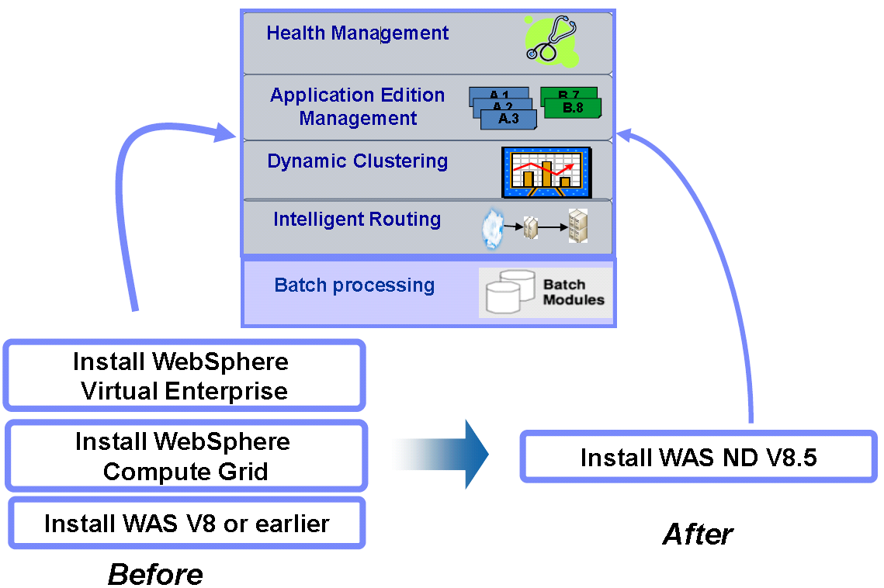
WAS ND V8.5: Resiliency enhancements –
WebSphere Virtual Enterprise & WebSphere Batch

Slide 35
WebSphere Application Server:
ODR Demo

Slide 36
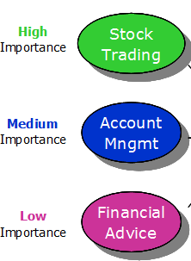



Intelligent Management Scenario
The On Demand Router applies sophisticated classification and flow control algorithms to intelligently manage workload
Classification
Prioritization and Flow Control
Routing and Load Balancing
Node 1
Placement Executions
Node 2
Node 3
WebSphere On Demand Router (ODR)
Node 4
Node 5
Application Demand
Resource State
WebSphere Decision Makers
Placement
Decisions
Routing, Health and Service Policies
Notes:
36
The dynamic operations features of WAS ND v8.5 gives you the capability to build a dynamic, virtualized, goal-oriented environment for workload management.
Picture an example scenario in which there are three applications with different relative importance to the business and hence differing quality of service expectations.
As these requests start flowing in, the ODR
1. Classifies these requests
2. Prioritizes and establishes flow control as per the established service policies
3. and Routes the requests honoring the flow control that was established.
The Dynamic application placement feature enables starting and stopping server instances to accommodate changes in load, balancing processing power among your applications to best meet your defined performance goals.
In the event of a node failure, the ODR automatically detects this failure and the dynamic application placement capability built into WA ND v8.5 enables the workload to be automatically re-routed to the available nodes, while continuing to meet the established your defined performance goals with the available hardware resources.

Slide 37
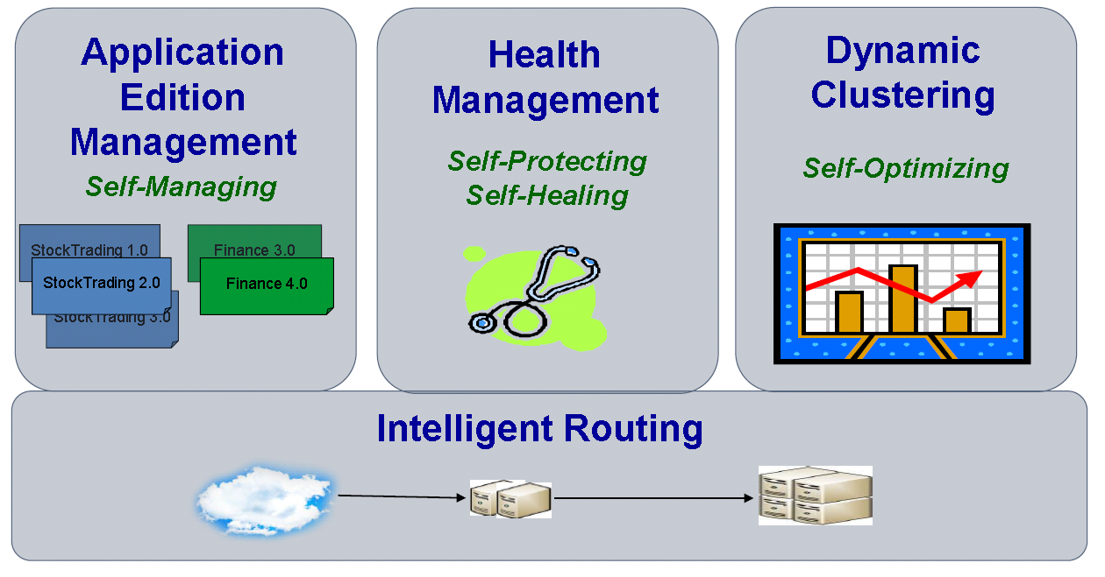
Intelligent Management
Extending QoS through autonomic computing

Slide 38

Application Edition Management
How you looks like when you update your application

Slide 39
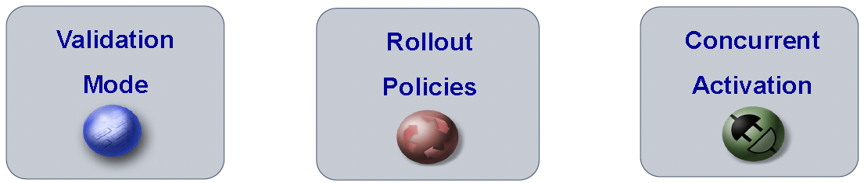
Application Edition Management
Applications can be upgraded without incurring outages
Upgrade Applications without interruption to end users
Concurrently run multiple editions of an applications
Automatically route users to a specific application
Multiple editions can be activated for extended periods of time
Rollout policies to switch from one edition to another without service loss
Easily update OS or WebSphere without incurring down time
Easy-to-use edition control center in admin console, plus full scripting support

Slide 40
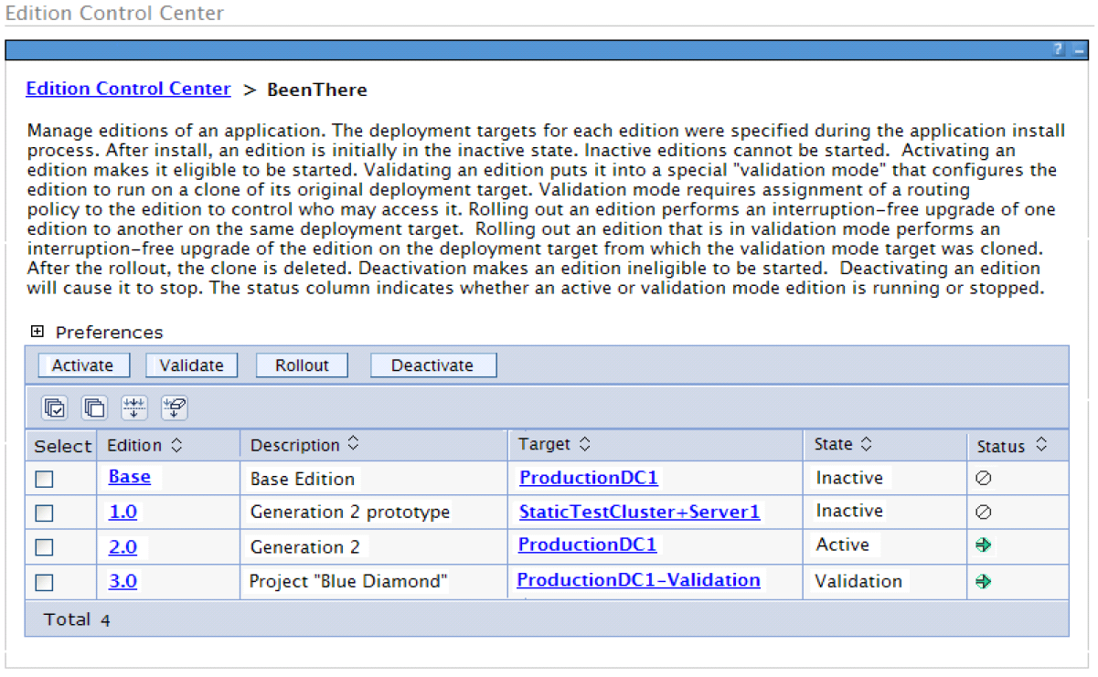
Application Edition Management
Administrative Console - Edition Control Center

Slide 41
Intelligent Management
Extending QoS through autonomic computing

Slide 42

Health Management
Sense and respond to problems before end users suffer an outage
Automatically detect and handle application health problems
  Without requiring administrator time, expertise, or intervention
Intelligently handle health issues in a way that will maintain continuous availability
Each health policy consists of a condition, one or more actions, and a target set of processes
Includes health policies for common application problems
Customizable health conditions and health actions

Slide 43
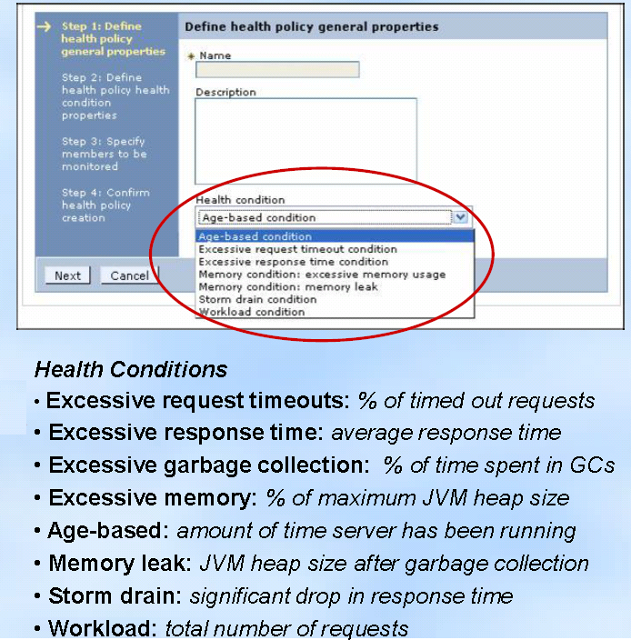
Health Management – Health Policies
Helps mitigate common health problems before outages occur
Health policies can be defined for common server health conditions
When a health policy's condition is true, corrective action execute automatically or require approval
  Notify administrator (send email or SNMP trap)
  Capture diagnostics (generate heap dump, java core)
  Restart server
Excessive response time means you are monitoring what matters most: your customer's experience!
Application server restarts are done in a way that prevent outages and service policy violations
Each health policy can be in supervise or automatic mode. Supervise mode is like training wheels to allow you to verify that a health policy does what you want before making it automatic.

Slide 44
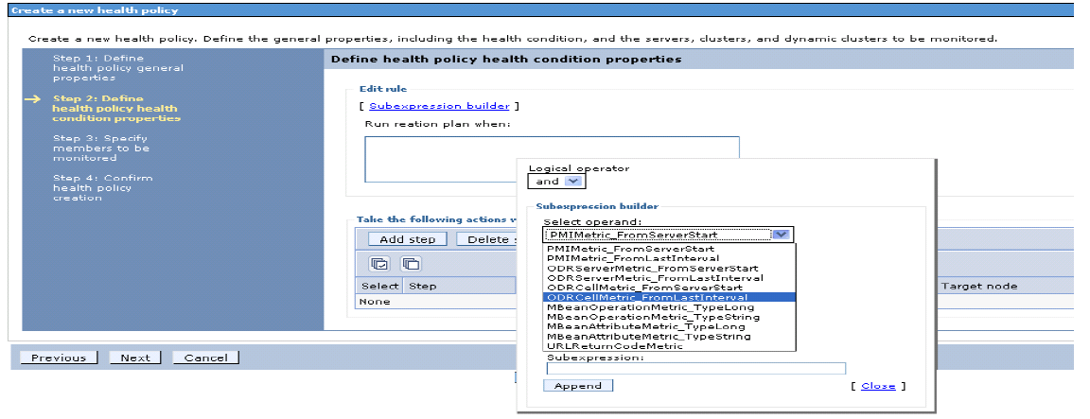
Health Management – Custom Health Conditions
Flexibility to determine what an “unhealthy” condition is…
Custom expressions can be built which use metrics from:
  The On Demand Router, URI return codes
  PMI metrics, MBean operations and attributes
  Examples: hung thread detection, DB connection pool exhaustion or slow down
Complex boolean expressions using a mix of operands is supported (AND, OR, NOT)

Slide 45
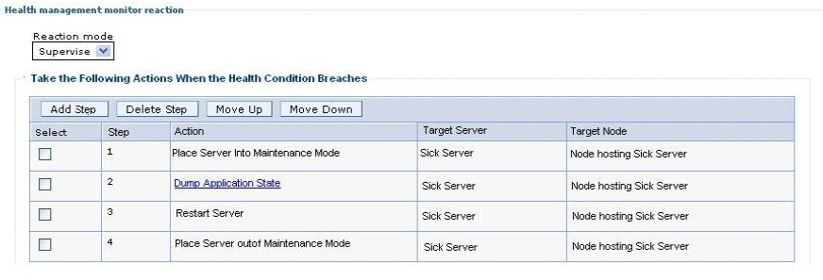
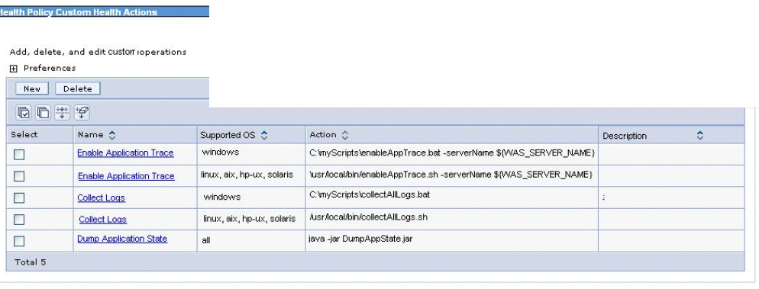
Health Management – Custom Health Actions
Provides flexibility by allowing the definition of custom actions allowing administrators to define an action plan to be carried out when the unhealthy situation detected.

